Slide 1
GLBA Pretexting Protection
Gunnar Yonker

Slide 2

Introduction: GLBA and Pretexting Protection
Gramm-leach Bliley Act (GLBA) is a federal law that regulates the collection, use and disclosure of sensitive information by financial institutions
Pretexting is one of the tactics used by hackers to gain unauthorized access to personal sensitive information
GLBA requires financial institutions to implement appropriate security measures to protect customers sensitive information from pretexting attacks
https://cdn-gabgk.nitrocdn.com/BrPHNalDwAjVbOXZFQiuifVvJqaUksgw/assets/images/optimized/rev-dc0600f/asset/images/article/Gramm-Leach-Bliley-Act.jpg
https://www.ftc.gov/business-guidance/privacy-security/gramm-leach-bliley-act

Slide 3
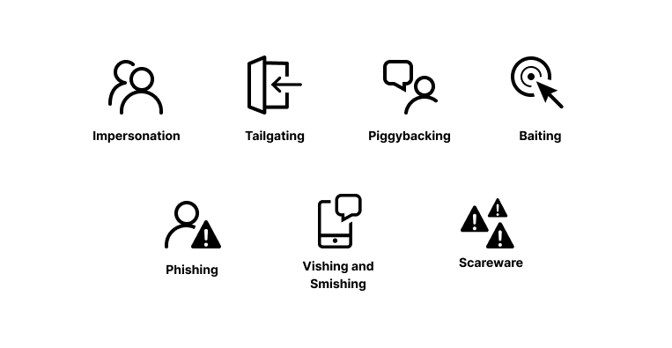
What is Pretexting?
Pretexting is a social engineering tactic in which an attacker creates a false identity or scenario to obtain sensitive information from an individual or organization
The attacker may impersonate a legitimate entity to trick the victim into revealing their personal information
Pretext attacks can come in different types
https://www.imperva.com/learn/wp-content/uploads/sites/13/2021/12/Types-of-pretexting-attacks.png

Slide 4
Pretexting Attack Examples
An attacker could call a customer service representative and make the claim that they lost their account password pretending to be the victim. The representative may disclose the password reset information to the attacker if they are not careful about confirming their identity in another way.
Another example is that an attacker could pretend to be an IT support technician and request access to a user’s computer claiming they need to fix an issue. If the user allows this, then the attacker would be able to use this access to steal sensitive information.

Slide 5
Pretexting Protection
GLBA requires financial institutions to implement a comprehensive information security program to protect their customer’s sensitive data
Financial institutions must conduct regular risk assessments to identify potential threat and vulnerabilities
Employees also needs to be trained to recognize and respond to pretexting attacks appropriately
Such as in the previous example situation, the employee verifying the identity of the caller before offering a password reset
https://www.csoonline.com/article/3598568/glba-explained-what-the-graham-leach-bailey-act-means-for-privacy-and-it-security.html

Slide 6
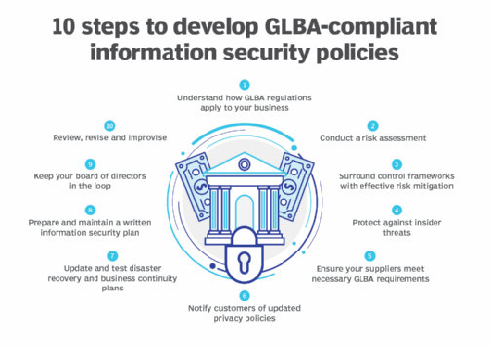
GLBA Standards for Pretexting Protection
Institutions needs written policies and procedures for detecting, preventing, and responding to pretexting attacks
Policies can include
Limiting amount of information disclosed to unauthorized individuals
Verifying identity before disclosing any information
Institutions should also implement technical safeguards such as access controls and encryption to properly protect sensitive information from third-parties
https://cdn.ttgtmedia.com/rms/onlineimages/cio-10_steps_to_develop_glba_compliant_information_security_policies-f.png

Slide 7

Case Study – ChoicePoint Data Breach
ChoicePoint is a background screening service provider that suffered a massive breach in 2005 due to pretexting attacks
Attackers posed as legitimate businesses to obtain sensitive information such as SSN and credit reports on over 163,000 individuals
The outcome of this attack resulted in ChoicePoint paying out $15 million in penalties and legal settlements
Another result was that this led to the passage of new data breach notification laws
Required companies to notify affected individuals in the event of a data breach
https://teachprivacy.com/wp-content/uploads/2006/01/ChoicePoint-Data-Breach.webp
https://www.ftc.gov/news-events/news/press-releases/2006/01/choicepoint-settles-data-security-breach-charges-pay-10-million-civil-penalties-5-million-consumer

Slide 8

Case Study – Hewlett-Packard (HP) Boardroom Scandal
Hewlett-Packard was involved in a pretexting boardroom scandal in 2006
HP executives hired private investigators to obtain phone records of board members and journalists in an attempt to identify the source of an information leak
Investigators used pretexting attacks to obtain the records
They impersonated the HP board members and journalists to obtain their phone records
This led to criminal charges and a settlement with the Securities and Exchange Commission
https://en.wikipedia.org/wiki/Hewlett-Packard_spying_scandal
https://www.theguardian.com/business/2006/sep/07/2
https://static.seekingalpha.com/uploads/2017/9/3/48008194-15044403996590211.png

Slide 9
Pretexting Conclusion
Pretexting is a threat to the security of sensitive information and has a variety of different attack methods
GLBA requires financial institutions to implement comprehensive security programs that address this threat
Pretexting Protection consists of:
Appropriate polices and procedures
Training employees to recognize and respond to these attacks
Implementing technical safeguards

